Slide 1

Decision Intelligence, for Everyone, Everywhere
© PreEmpt.Life 2025
Notes:
1

Slide 2
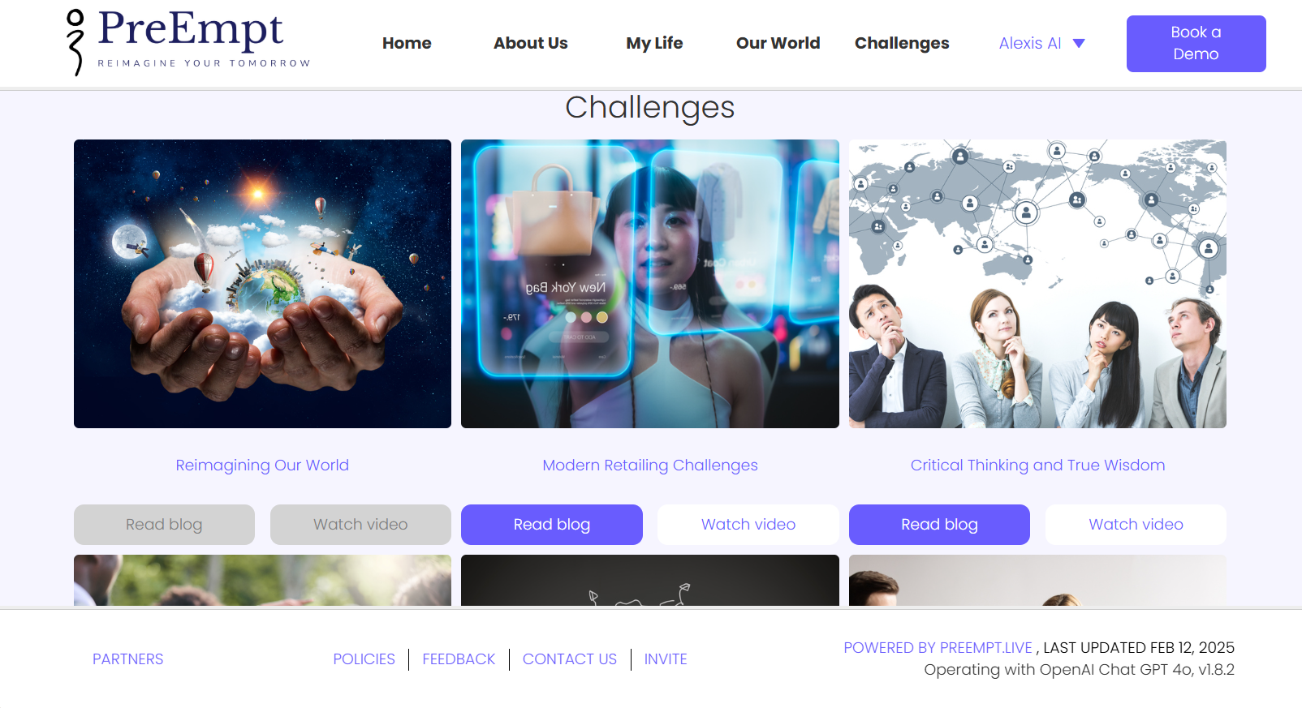
PreEmpt Vision
To democratize strategic foresight and decision intelligence—making advanced, AI-driven futures thinking and scenario planning accessible, participatory, and actionable for all people and organizations, regardless of size, budget, or sector.
With the ultimate goal to transform the quality, inclusiveness, and reach of strategic foresight—helping the world’s innovators, leaders, and citizens to not just predict, but actively shape their futures.
Key Elements:
Holistic, AI-Human Foresight
Democratized Access for all
Empowerment for All Sectors
Collaborative Innovation
Speed, Resilience, and Ethics
© PreEmpt.Life 2025
Notes:
2

Slide 3
PreEmpt – What Does It Do ?
PreEmpt helps organizations and individuals think ahead, plan for the future, and make better intelligent decisions
Horizon Scanning
Identifying early and weak signals of change, to stay ahead of your competitors
Strategic Game-planning
Developing alternative scenarios for intelligent decision-making in uncertain environments
Risk Management
Systematically assessing and responding to potential threats
Innovation Development
Collaboratively imagining and creating new futures, with human oversight
Critical friends
Systematically gathering insights from communities as feedback or research
Change Management
Establishing fresh visions and understanding, to engage stakeholders effectively
© PreEmpt.Life 2025
Notes:
3

Slide 4

Typical Use-cases Across Multiple Industry Sectors
Collaborative Problem Solving for Wicked Problems:
Engaging the broadest team to understand, connect and address the most challenging scenarios.
Innovative Thinking:
Speculate to tackle the unknown unknowns, with real-time connectivity. Answers now - not ‘if and when’.
Policy Development:
Creating new connected policy responses addressing complex, new-world / real-world scenarios.
Drive Gameplan to Action:
Creating roadmaps, approach and gameplans, with step-by-step process to ensure action immediately.
“We are not trying to be the smartest model
- we're helping to build smart organizations.”
© PreEmpt.Life 2025

Slide 5




PreEmpt.Life delivers Decision Intelligence for Everyone, Everywhere through Targeted Use Cases
Durable infrastructure that enables people & organisations think ahead, plan for the future & make better, more informed, & timely decisions
 | Policy & Resilience | Typical Benefits
Policy Development | Model policy scenarios and stakeholder impacts to develop evidence-based policies and regulation
Crisis Management | Provide real-time decision support and resource allocation during emergencies and organizational crises
Scenario Planning | Explore multiple future possibilities and test strategic assumptions to prepare for uncertainty
Resilience and Risk | Identify and assess operational, financial, and strategic risks to develop adaptive mitigation strategies
 | Market & Growth | Typical Benefits
New Product Launch | Analyze markets, forecast demand, and optimize launch strategies to maximize success probability
Market Analysis & Match-making | Evaluate market structures, entry barriers, and timing for successful market penetration strategies
M&A Strategy | Support due diligence, synergy analysis, and integration planning for M&A transactions
Competitor Analysis | Monitor and analyze competitor strategies, capabilities, and positioning for competitive intelligence
Accelerated decisioning
Accessible intelligence
Finding solutions to difficult pain points and challenges, fast
Proactive risk identification and mitigation
Near real-time assessment
Expert advice on tap
Accelerated decisioning
Accessible intelligence
Enhanced collaboration
Efficient project launch and execution
Proactive risk identification and mitigation
Democratized and equality of access
Expert advice on tap
 | Innovation & Collaboration | Typical Benefits
Collaboration Networks | Create secure networks for knowledge sharing and collaborative innovation among trusted partners
Innovation Sprints | Structure rapid innovation and problem-solving sessions using collaborative intelligence methodologies
Collaborative Solving for Wicked Problems | Address complex multi-stakeholder challenges through cross-sector collaboration and systemic solutions
 | Development & Foresight | Typical Benefits
Organizational Self-Audits | Evaluate organizational performance and capabilities to identify improvement opportunities and gaps
Education and Capacity Building in Foresight | Develop organizational capabilities in strategic foresight and decision intelligence methodologies
Personal Future and Career Planning | Provide decision support for individual career development and life planning using predictive analytics
Critical Friends & Research | Enable research and opinion gathering to strengthen and shape ideas/challenges
Enhanced collaboration
Efficient project launch and execution
Greater agility in navigating complex challenges
Finding solutions to difficult pain points and challenges, fast
Democratized and equality of access
Accessible intelligence
Democratized and equality of access
Human-centered, ethical AI focus
Expert advice on tap
Reduces cost of research
© PreEmpt.Life 2025
Notes:
5

Slide 6
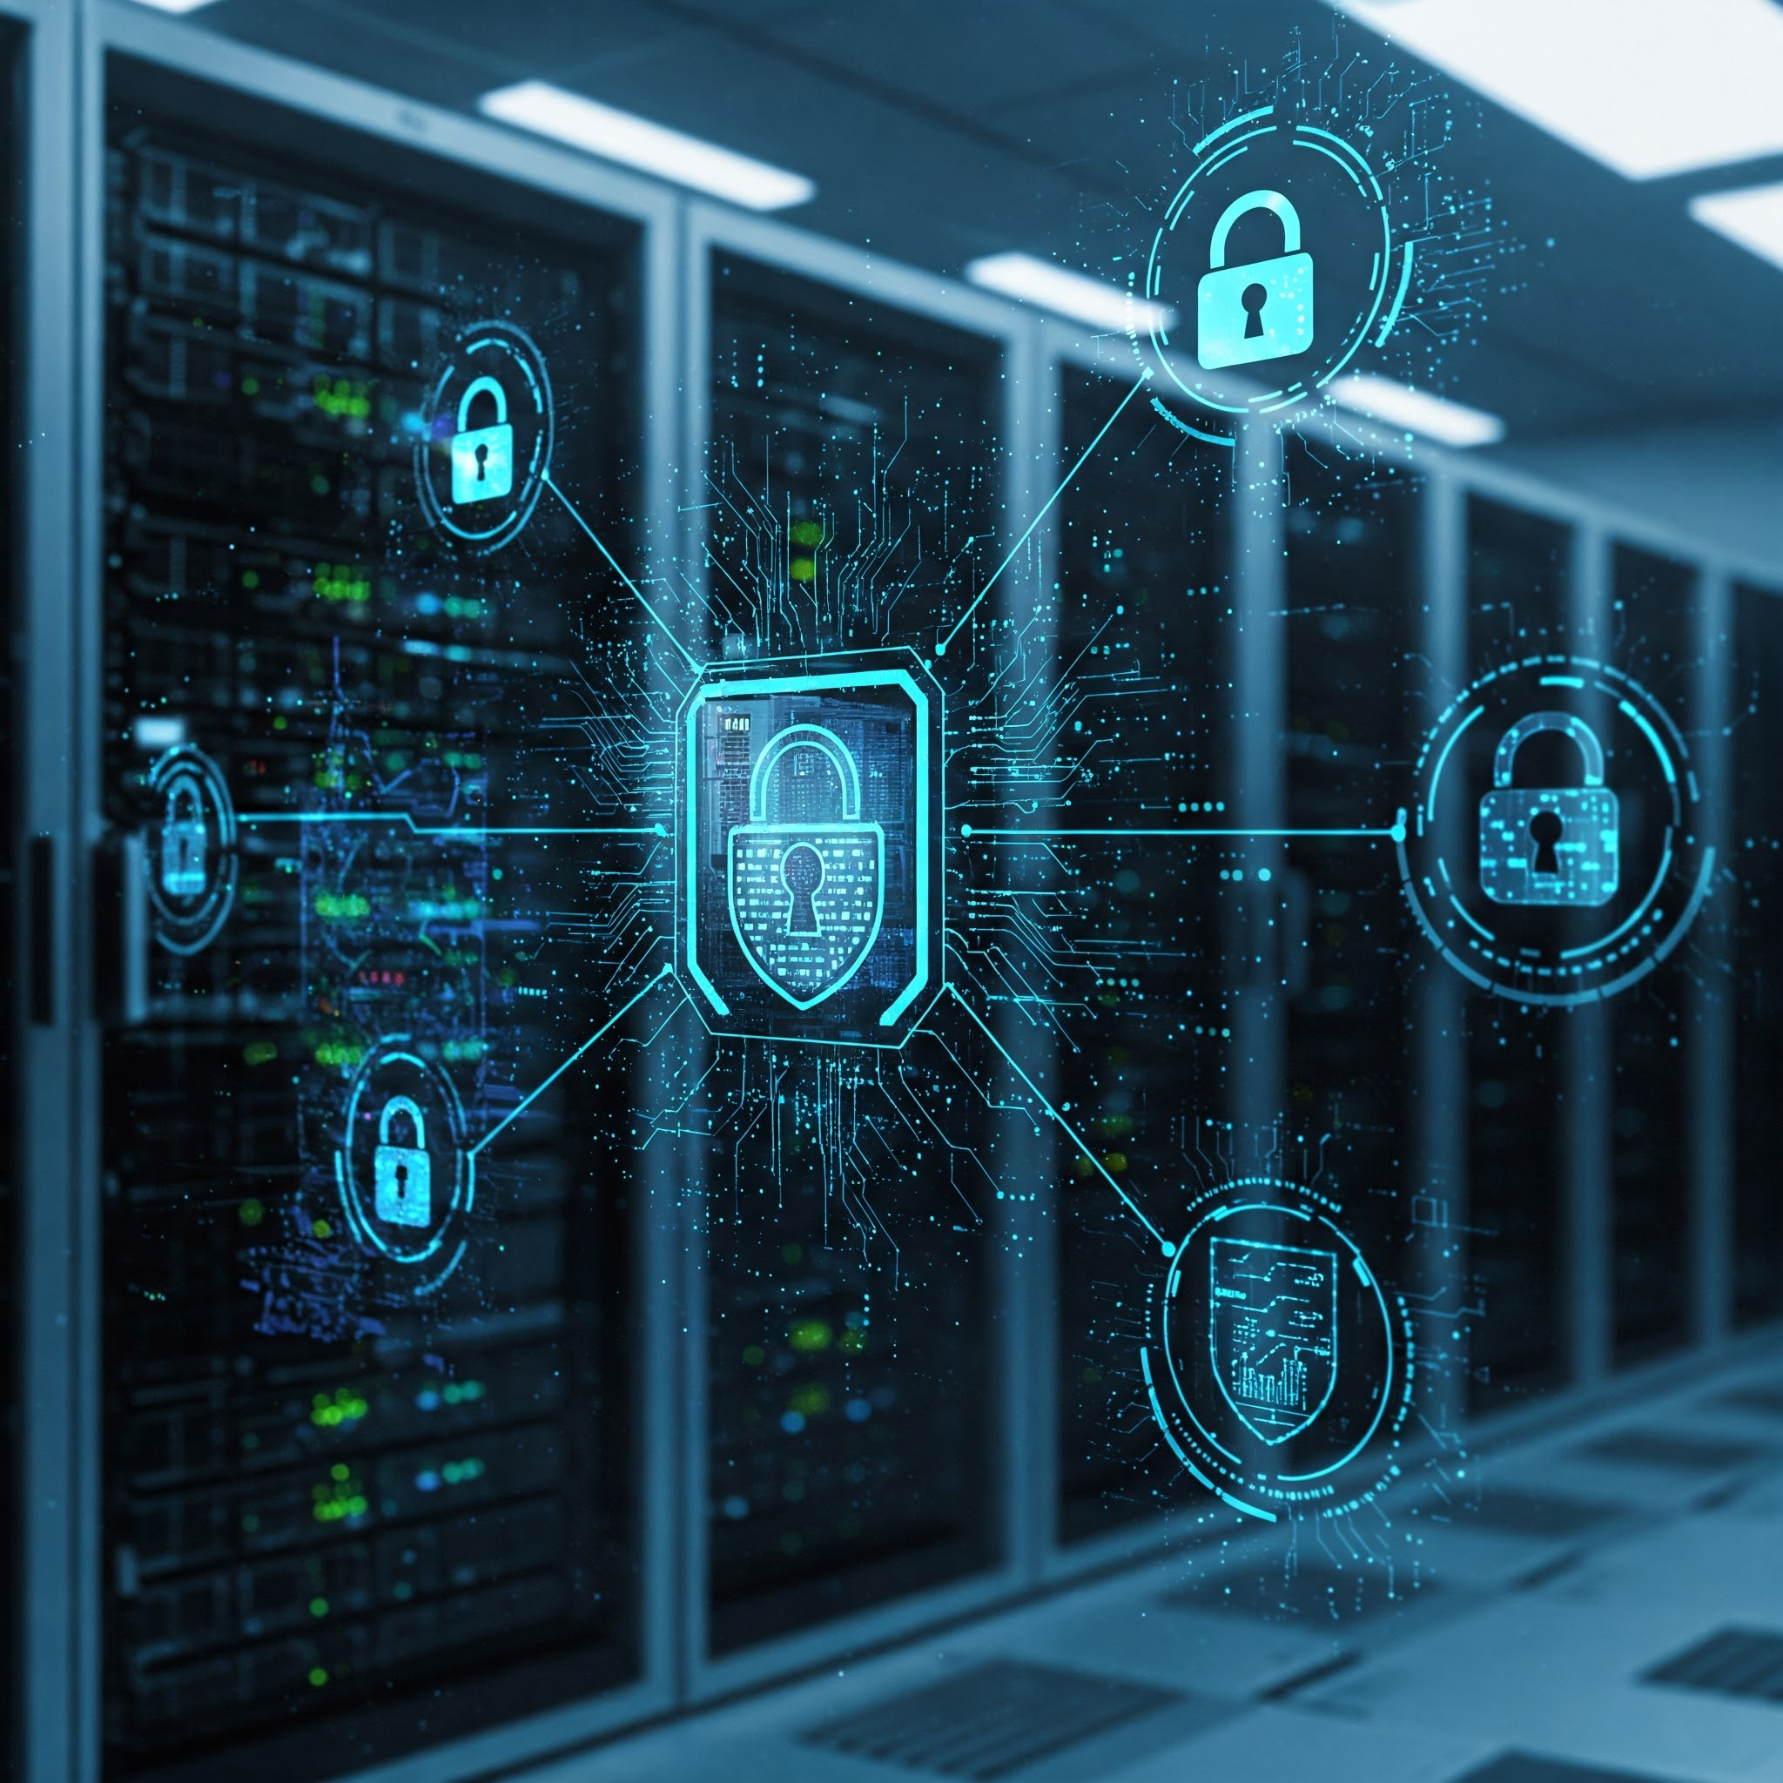
How Does it Work ?
You provide a problem definition and add context, and PreEmpt works by assessing publicly available data from the internet and proprietary data
Dedicated private client sites holding any client specific data you provide and sensitive report outputs
PreEmpt analyses huge amounts of information and uses 1,000+ prompts and methods to come up with possible and deviant futures, risks and opportunities, presented as lenses into the content, all overseen by you as human arbiters
The content can then be individually consumed, considered, shared, and workshop’d, depending on your purpose, with full support if required
Any client-specific proprietary data is secured and kept anonymous on AWS Cloud
Automated and manual links to other engines for further analysis, video, slides, summaries, and as independent verifiers and critics of generated reports, prior to delivery to you
No-one else can view your content (including the PreEmpt team), unless you share it
© PreEmpt.Life 2025
Notes:
6

Slide 7
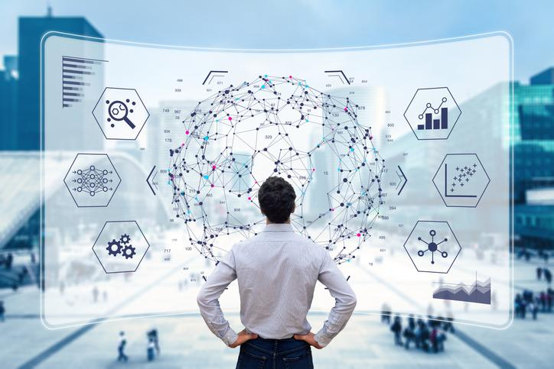
Visualization & Understanding
A recent survey (2025) showed that 65% of people identify as visual learners, that auditory learners make up about 30% of the population, and approximately 5% of people are primarily kinesthetic learners
Our Challenges page gives you ~3 minute videos, 5 minute blog posts, and immensely detailed reports to read. Your choice.
We have incorporated Causal Knowledge Graphs to aid the visualization of the delivered reports, with drill-down nodes for greater detail
All reports can be further questioned, analysed and reformatted with connections to other GPT LLMs of your choice, to enhance interpretation and understanding of the responses
© PreEmpt.Life 2025

Slide 8

What Makes PreEmpt Different
Easy for Everyone: It’s designed so that anyone, not just experts, can use advanced future-planning tools for free, or at low cost
AI + Human Input: While PreEmpt does the heavy lifting, you can add your own data, opinions and ideas, making the results personal and relevant
Covers Everything: It can look at all topics, from business trends to personal goals, and answer questions in 37+ different languages and from the perspective of different cultures and personas
Non-Linear: PreEmpt is holistic, has built-in feedback and verification loops so that any new data introduced anywhere in the cycle, creates an amended response. With linear systems, it’s a straight line, a serial set of steps that requires re-running
It Helps You “Think Ahead”: Instead of just reacting to problems, Alexis helps you spot weak signals early and act before they become an issue.
It is like having a weather forecast for your life or business
© PreEmpt.Life 2025

Slide 9
PreEmpt Features and Benefits (Based on Perplexity independent assessment - June 2025)
Key Feature | PreEmpt.Life | Rivals (Average)
Trend & Faint Signal Detection | Scans Millions of evidence points to identify faint, collapsing and reemerging signals for early advantage | Focus on mainstream trends, limited faint signal detection
Scenario & Simulation Capability | Generates hundreds of recursive, multi-domain scenarios and runs 500+ virtual laboratory simulations | Offers few, static scenarios with basic simulation tools
Systems and cross-disciplinary analysis | Integrates advances frameworks (PESTLEC, CAS, feedback loops) and 37+ disciplines for holistic solutions | Siloed or optional systemised tools, minimal interdisciplinary integration
AI Power, Self-audit and Explainability | Uses 1,000+ methods, 2,500 synthetic experts, 500 expert reviewers, 100,000+ critical friends, every output undergoes a 12-step self-audit and is fully explainable | Fewer methods, limited validation, rare self-audit or explainable logic
Ideation, Threat and Gamechanger Identification | Recursively identifies threats, opportunities and gamechangers, maps disruptors and start-up trends | Basic SWOT/PESTLE, rarely flags gamechangers or faint threats
Value for money and Accessibility | Deliuvers tailo9red, multi-lingual, expert-reviewed reports in 12-16 hours at accessible pricing for all users | Reports take weeks/months, are costly and less accessible
© PreEmpt.Life 2025

Slide 10
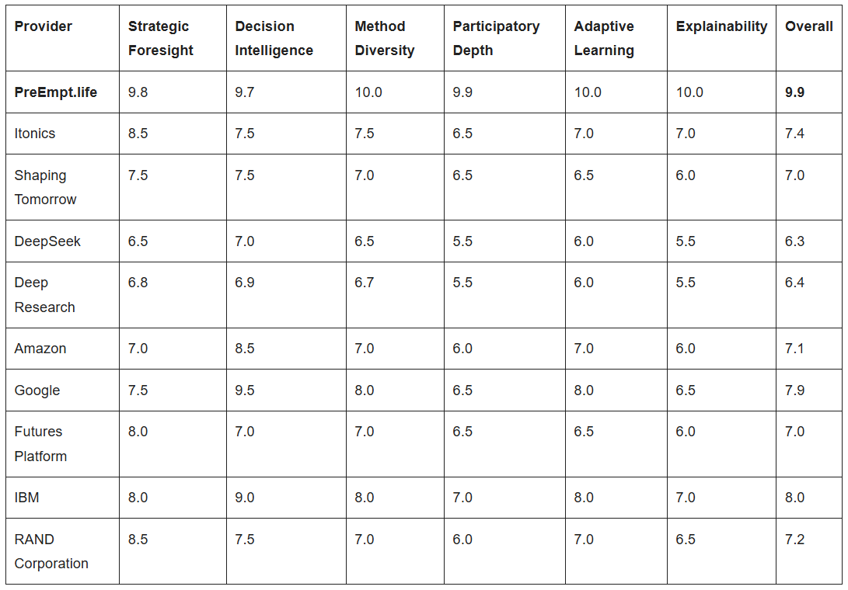
Competitive Positioning (Based on Perplexity independent assessment - June 2025)
Comparison of PreEmpt vs Competitors (June 2025)
PreEmpt leads the field (average 9.9/10) with a significant product advantage across competitors (average 7.2/10)
© PreEmpt.Life 2025
Notes:
10

Slide 11
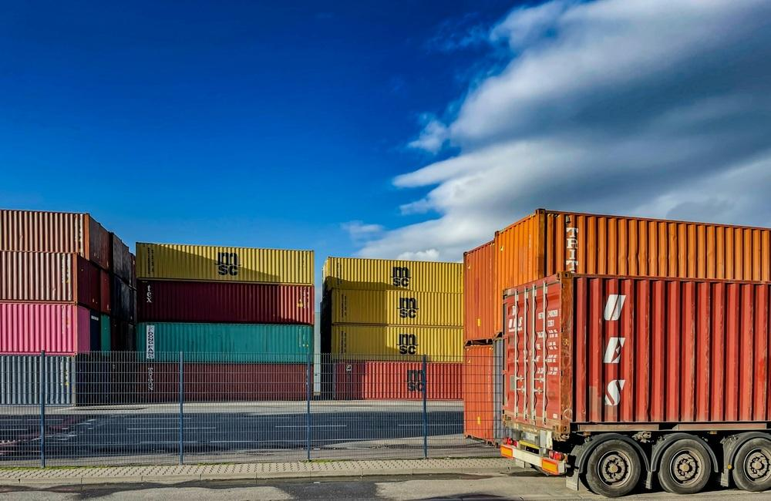
Deploying PreEmpt
Securely register on the website to ask your questions; however complex or simple
If you are unsure what or how to ask our system will help you phrase the right questions, to get the most detailed and relevant answers
Upload your proprietary data. It is secured and kept anonymous on AWS Cloud
Main AI engine for research and analysis is ChatGPT’s latest model, regularly updated
Automated / manual links to other engines
for video, summaries, further analysis and as independent verifiers and critics of generated reports, prior to delivery
© PreEmpt.Life 2025
Notes:
11

Slide 12
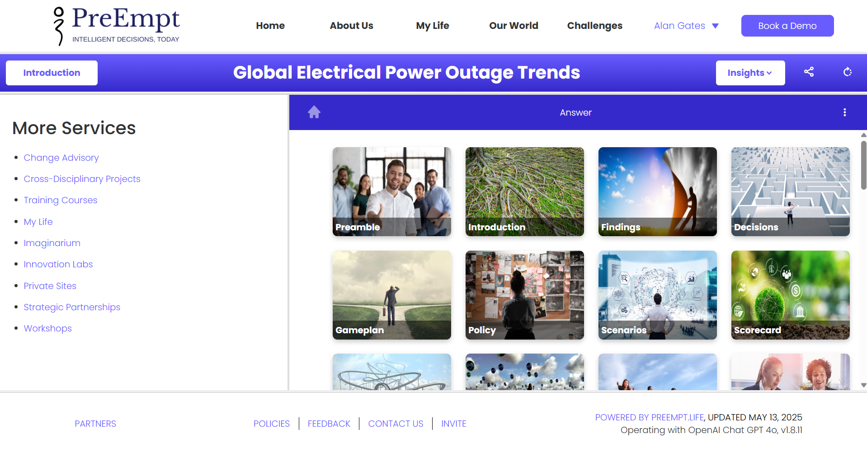
What Underpins the PreEmpt System
1,000+ integrated foresight, strategy, design, system and critical thinking methods and prompts
5,000+ embedded, conceptual, vital and future-oriented questions
Holistic, practical, inspiring and engaging solutions
250+ scenarios on any topic
500+ suggested innovative ideas
Specific prompts to support Operational Resiliency requirements
Tools for teamwork and inter-disciplinary collaboration
AI and humans as co-creators across roles and organization boundaries
Cost accessibility for democratization of expertise to all
Ethical and sustainable with built-in self-regulation via Recursive Criticism & Improvement (RCI)
© PreEmpt.Life 2025
Notes:
12

Slide 13
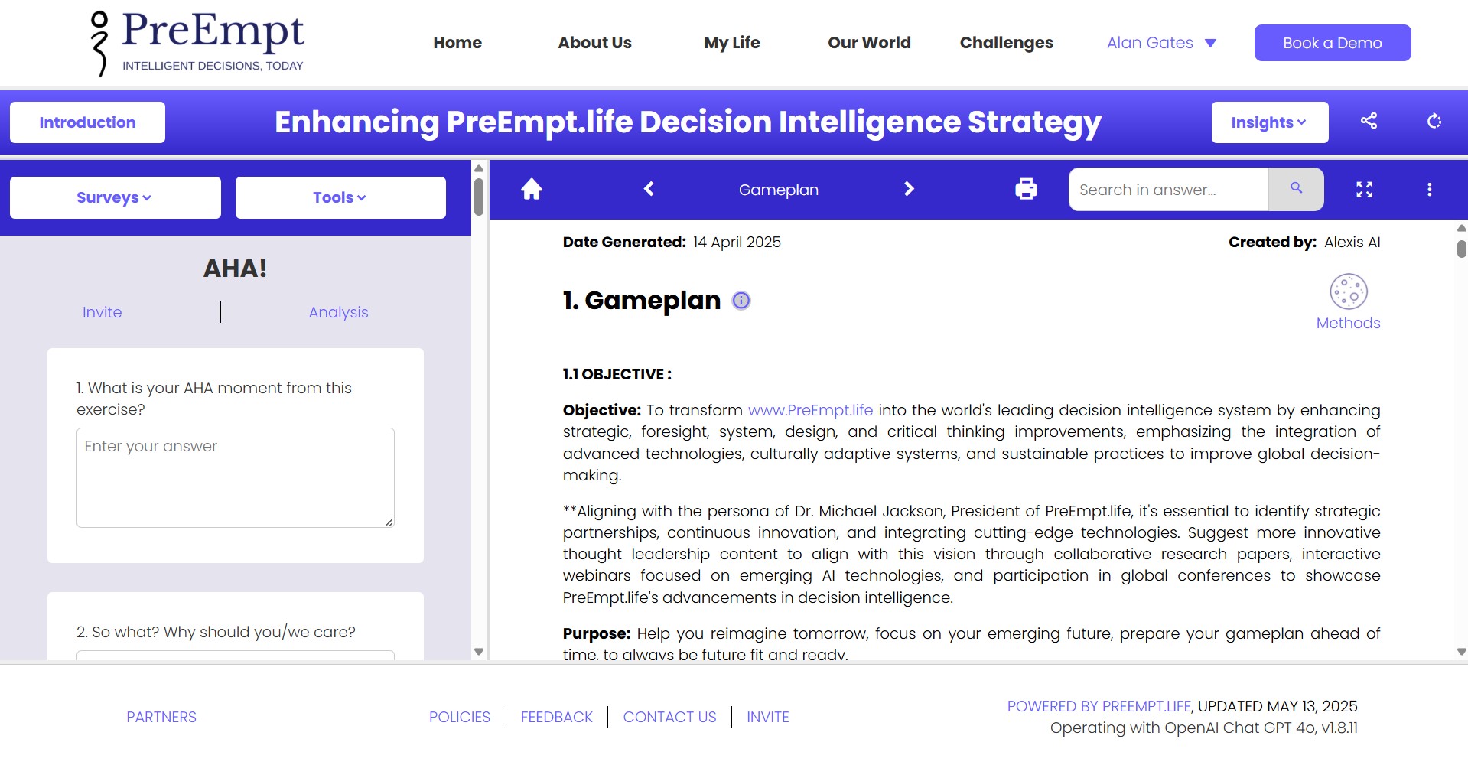
Human Creativity
What role does human creativity play in PreEmpt.Life's intelligent decisions?
Idea Generation: Creative input allows teams to brainstorm diverse solutions, moving beyond conventional approaches to real problem-solving
Direct human input: Updated human views can be included in AI analysis at any stage of the process
Contextual Insight: Humans provide contextual understanding and emotional intelligence that AI lacks, enabling more nuanced interpretations of data and trends
Scenario Development: Combining human imagination with AI-generated data helps create rich and varied future scenarios, fostering strategic game-planning and adaptability
© PreEmpt.Life 2025
Notes:
13

Slide 14
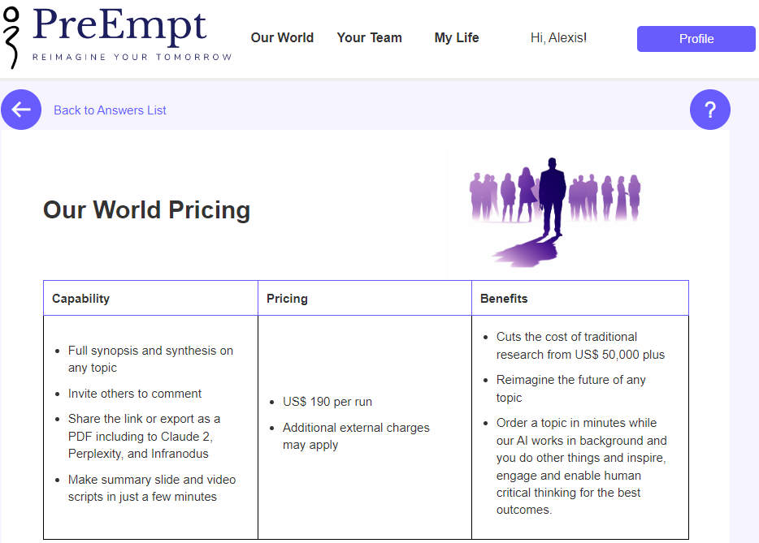
Pricing
We are pioneers in Price Competitiveness and Value for Money
Price per single report: $360 USD
Custom private client sites: $16,000 USD per annum with dedicated private site
Significant cost savings compared to traditional consultancies
We also offer multi-year deals for long term commitment with committed pricing
WE WILL COMMODITISE DECISION INTELLIGENCE
FOR THE BENEFIT OF ALL
Client sites
White labeled in your colors and logo
Fully secure to provide specific client data
Private Challenge library
24 reports per annum
Full visualization suite
Full PreEmpt support
© PreEmpt.Life 2025
Notes:
14

Slide 15
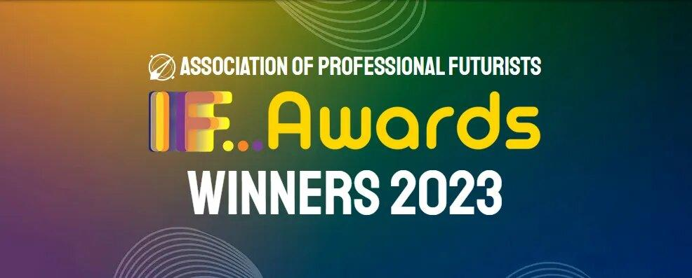
Ethics and Sustainability Principles
We are delivering human-centric AI solutions underpinned by:
Explainable and Self-auditing AI that turns a black-box into a near white-box
Built-in prompts to be respectful of human rights, including Safe, Sustainable, Fair, Trustworthy and Explainable AI
Fully focusing on AI for universal human good
AI controllable only by humans and in multiple languages
As winners of the Association of Professional Futurists Awards in 2023, we have a strong AI ethics ethos baked into the fabric of our operations
© PreEmpt.Life 2025
Notes:
15

Slide 16

Safety & Security
.
Our strategies collectively contribute to a secure environment for users
Adaptive Security Integration: We utilise near real-time identity-based threat prevention, which continuously assesses user behavior and access risks, to preemptively address potential threats
Zero Trust Architecture: This approach ensures that all users, both inside and outside the organization, are treated as potential threats, requiring verification for access - no exceptions, ever
Continuous Monitoring: The platform analyses user actions and can trigger multi-factor authentication when suspicious behavior is detected, enhancing overall security posture
We do not use AI Agents for access, believing that whilst they are transformative, they present several risks across technical, ethical and societal dimensions
© PreEmpt.Life 2025
Notes:
16

Slide 17
Feedback and Testimonials
A few of many - all of which can be accessed and verified on our website: https://www.preempt.life/feedback.html
.
I came up with a question and submitted it along with a lot of context to PreEmpt. The first thing PreEmpt did was to tell me that my question could be improved! So I took it’s suggestion and submitted my question. Five hours of compute time later, out popped my comprehensive answer. I was literally blown away by the quality and depth of the response.
Rob Baldock, MD - Clustre Solutions Brokers -UK
What you are doing left me feeling like I just unlocked a magic door (was definitely the most impressive thing I’ve seen in years)!
Jon Gress, CEO - The Metaverse Construction Company LL
By partnering with PreEmpt.life we were able to bring together the very best of AI and human intelligence, with an approach to strategic foresight and workshop design that saved huge amounts of resource, meaning we had all the more room to focus on co-creation, engagement, and delivery.
Emily King, Emily King Associates, UK
As the City of London’s leading think tank, PreEmpt helps us reimagine our approach to problem-solving. PreEmpt forms part of our methodology to ensure we take in the widest possible universe of potential problems and solutions, while the system ensures we are not overwhelmed. All in all, PreEmpt is one of the best tools in our toolkit.
Michael Mainelli, Professor, Chairman of Z/Yen Group & Late Lord Mayor of London 2023-2024
PreEmpt is the next stage in the evolution of tools to assist decision-makers in better understanding the competitive environment. By integrating many tools and analytical techniques, Preempt life makes it possible to be better prepared for what is a more uncertain future
Jonathan Calof, Professor, University of Ottawa SCIP/CI Fellow
I found PreEmpt to be unbelievably quick in ingesting large quantities of human written content, and then producing a well written and articulate summary. As with previous AI platforms I had expected to find elements of truth conflated with fiction, but I was astonished to find the output from PreEmpt was both concise and accurate.
Michael Taylor, CEO - Matrix Connexions, UK
© PreEmpt.Life 2025
Notes:
17

Slide 18

The PreEmpt Roadmap
.
Major developments in progress … but clients and technology advancements will reveal other areas to consider
Improved Visualization and UI
Hypergraphs and Virtual Reality
Interoperability
Predictive Analytics
Leverage Quantum Computing power
Critical Friends and Research
Recursive Criticism and Improvement (RCI)
Let PreEmpt be your guide to Intelligent Decisions. Find your way at: PreEmpt.Life
© PreEmpt.Life 2025
Notes:
18

